Slide 1
HPCaaS with DEMO
Ákos Kovács
Széchenyi István University (SZE)
Joint work with Z. Horváth (Head), B. Liszkai, Á. Kovács, T. Budai, Cs. Tóth (SZE)
HiPEAC, European Network on High Performance and Embedded Architecture and Compilation
Bologna, 20-22 Jan 2020

Slide 2
Agenda
Two Main part
1. Simulating
2. Explanation

Slide 3
First let’s do some simulation ☺
Download the blueprint, that we have to edit
http://www.sze.hu/~leslie/hipeac
Uap.yaml -> save as
Or just copy the content of it
Open it with your favorite editor
Be advised!, YAML has strict whitespace rules

Slide 4
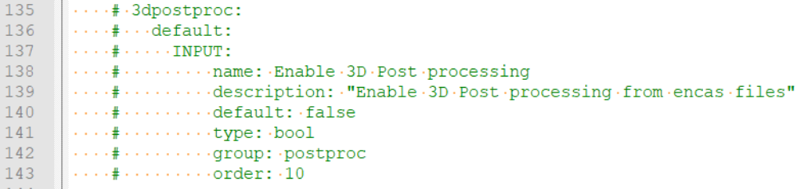
Editing YAML
Enabling a new option in the blueprint
  Uncomment the following lines: (just delete the hashmark (#))
  Line 135-143
  Line 190 -> comment 191

Slide 5
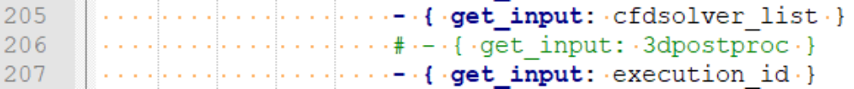
Editing II.
Uncomment line 206
Then save YAML to your computer, now we have to upload to portal.

Slide 6
Uploading the Simulation
Go to http://webint.hidalgo-project.eu
Login with your user/pass (paperslices)
Go to Settings/Manage Application
Add a name to your application
Select the file you previously edited, and hit upload!

Slide 7
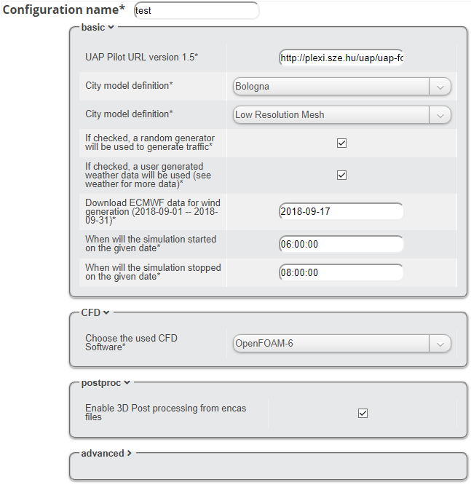
Configuring the Simulation
Go to Experiments/Manage Instances
Select your Application
  We uploaded to everyone the commented version to see the difference (No PostProc option)
  After the configuration save it

Slide 8
Starting the simulation
Go to Experiments/Execute
Choose your application
Choose your configuration
Choose 193.224.130.186 as HPC
Execute!

Slide 9
HPCaaS
Goal is to reach more people with HPC application
HPCaaS trough API, means it is possible to create web portal or CLI tools to manage HPC jobs/applications
Cloudify with HPC plugin

Slide 10
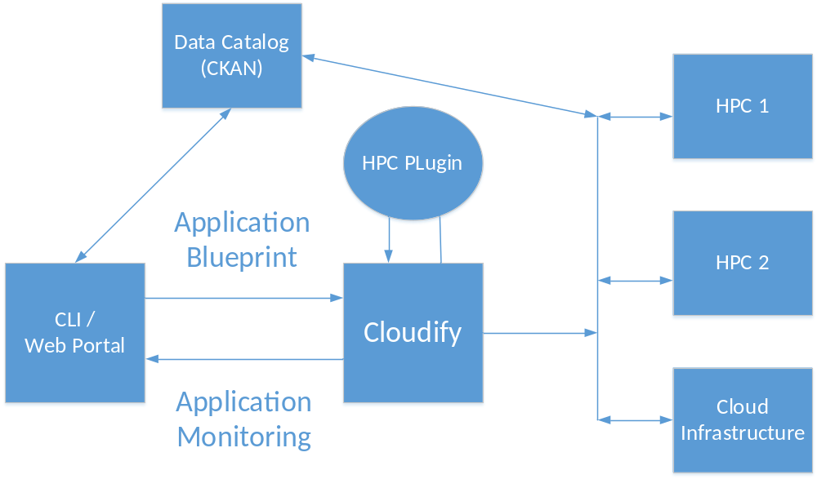
HPCaaS High level Architeture

Slide 11
TOSCA file
Topology and Orchestration Specification for Cloud Applications (TOSCA)
„The idea behind the TOSCA standard is to render improvements in the deployment, termination, and any other management function of cloud applications.”
Describing workflows and input data, and a relation between them.

Slide 12
Application Blueprint
YAML format (Human readable, less writable ☺)
  Strict whitespace rules
Defining application inputs, files, datasets
  Files to download
  Online File edit
  Lists
  Strings
  Checkbox (Boolean)
  Number (int,float)

Slide 13
Application Blueprint II.
Defining workflow
  Add executabe commands, with input files/string defined
  Add possibility to use Module system for HPC (Loading modules)
  Define simulation steps and add dependencies between them, so all steps can be serialized or parallelized

Slide 14
Data catalog
Ckan data catalog
Can be used trough API
Store files or just the URL of the file
Defining datasets
Datasets, and Files can be tagged, for easy search
Authentication with secret API key

Slide 15
Check our simulation
Go to Experiments/Dasboard
Your simulation name
Last log message
App name
See logs
Starting time
See results
(image gallery)
Status

Slide 16
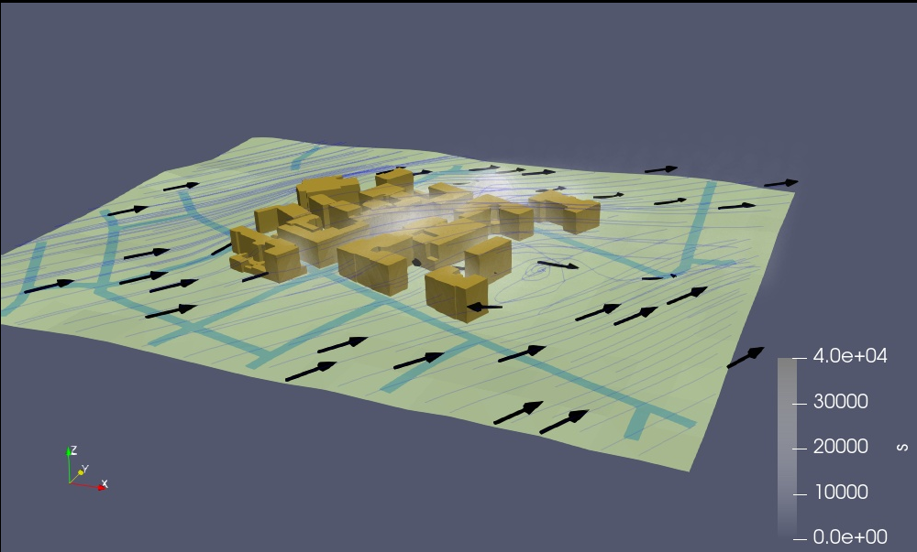
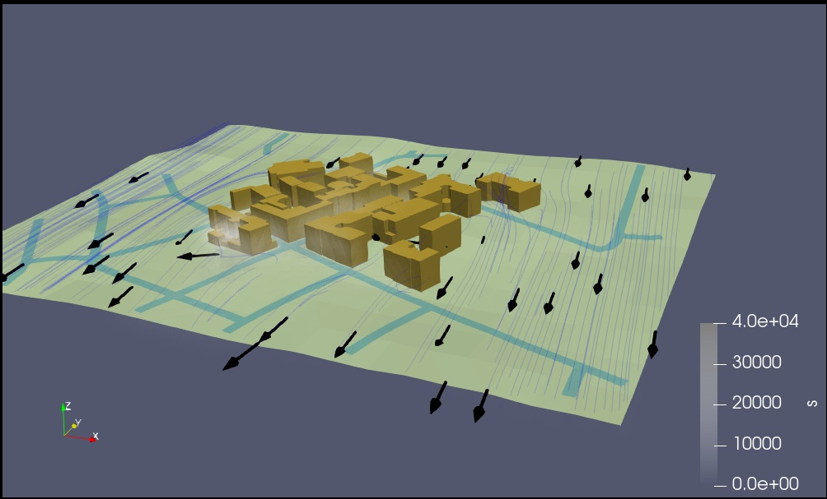
Results with two different wind profile
Generated wind
Downloaded weather data from ECMWF

Slide 17


THANK YOU !
QUESTIONS ?
Ákos Kovács
Széchenyi István University
Egyetem tér 1.
9026 Győr, Hungary
Email: kovacs.akos@sze.hu

